Slide 1
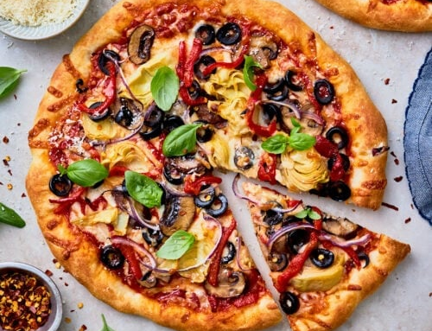
PIZZAS SALES SUMMARY ANALYSIS 2015
Presented by:
Edward Omovudu

Slide 2
Table of Content
Executive Summary
Business problems
Pizzas Sales Summary 2015 Dashboard
Findings
Recommendations
Thank you and Questions

Slide 3
Executive Summary
An overview of the summary analysis of Pizzas Company for the Year 2015.
Showing the analysis of the sales performance of different category of pizzas sold, quantity sold, their prices and total revenue generated.
Total Revenue of $78.24M generated over the Year 2015.
Quarterly and Monthly trend analysis of total pizzas sold.
Provides relevant insights that will help Pizzas boost its sales performance and increase total revenue.

Slide 4
Business Problems
According to the report published by GlobalData in December, 2020, Pizza market in Canada recorded a positive compound annual growth rate (CAGR) of 2.90% during the period 2014 to 2019 with a sales value of CAD 1,084.68 Million in 2019, an increase of 2.71% over 2018. The market achieved its strongest performance in 2018, when it grew by 3.25% over its previous year and its weakest performance in 2019, when it increased by 2.71% over 2018.
Due to the increase growth rate, the Pizza market had been competitive.
Pizzas needs to identify how to create a strong brand identity for itself in this competitive and challenging market.
Identify trends to stay relevant, consistency in customer satisfaction and attract new customers.
Increase total revenue.

Slide 5
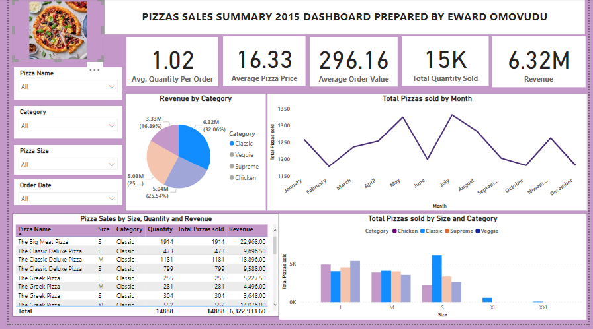

Slide 6
Findings
The Total Revenue generated for the Year 2015 was $78.24M with total pizzas sold of approx. 50k
“The Thai Chicken Pizza” generated the highest revenue of $29,257 with 1410 quantity sold.
However, “The Big Meat Pizza” had the highest sales with 1914 orders with a revenue of $22,968.
Pizza Name with “The Greek Pizza”, “The Green Garden Pizza”, “The Chicken Alfredo Pizza” and “The Calabrese Pizza” had the lowest quantity sold thereby generated the lowest revenue.
Highest Pizza sales was in July with total pizza sold of 4,392 while October had the lowest sales of 3,883.
Quarter 2 recorded the highest number of pizza sold with 12,586 orders as against Quarter 4 which had 12,084 orders.
The Classic category of Pizza had 32% (6.32M) of the Revenue while The Chicken category had the lowest of approximately 17% (3.33M) of the Revenue.
The Trend analysis shows there is a peak in July and decline in the trend towards the end of the Year.

Slide 7
Recommendations
For consistency in customer satisfaction, Pizza needs to do some promos to encourage more sales in The Thai Chicken Pizza and other pizzas which generate more Revenue and to attract new customers.
Conduct a market survey to know why there is low orders in Pizzas with the lowest sales.
Review the ingredients in making these pizzas with lowest record of sales, might be due to allergies.
Marketing team should examine or evaluate the cause of decline in sales between August and December, do some promotions to increase sales around this period.
Research team should continue to monitor and analyze sales trend and act accordingly in case of any emerging pattern.

Slide 8



